Slide 1
Global Query and Local Query

Slide 2
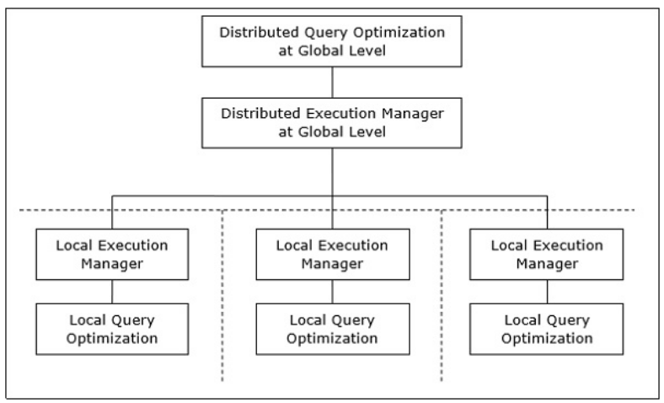
Distributed Query Processing Architecture

Slide 3
Mapping Global Queries into Local Queries
The tables required in a global query have fragments distributed across multiple sites.
The local databases have information only about local data.
The controlling site uses the global data dictionary to gather information about the distribution and reconstructs the global view from the fragments.
If there is no replication, the global optimizer runs local queries at the sites where the fragments are stored. If there is replication, the global optimizer selects the site based upon communication cost, workload, and server speed.
The global optimizer generates a distributed execution plan so that least amount of data transfer occurs across the sites. The plan states the location of the fragments, order in which query steps needs to be executed and the processes involved in transferring intermediate results.
The local queries are optimized by the local database servers. Finally, the local query results are merged together through union operation in case of horizontal fragments and join operation for vertical fragments.

Slide 4
Translation of Global Queries to Fragment Queries
There are several different ways to transform a query over global relations into queries over fragments. These different transformations produce fragment queries which are equivalent i.e the produce the same result.
The equivalence rules are used to for simplifying the query expressions: for instance, common sub-expressions are identified, and operations are distributed to fragments.
It has six specific rule to be precise.....
1) Use idempotence of selection and projection to generate appropriate selections and projections for each operand relation.
2) Push selections and projections down in the tree as far as possible.

Slide 5
Translation of Global Queries to Fragment Queries
3) Push selections down to the leaves of the tree, and then apply them using the algebra of qualified relations; substitute the selection result with the empty relation if the qualification of the result is contradictory.
4) Use the algebra of qualified relations to evaluate the qualification of operands of joins; substitute the sub tree, including the join and its operands, with the empty relation if the qualification of the result of join is contradictory.
5) In order to distribute joins which appear in the global query, unions must be pushed up, beyond the joins that we want to distribute.
6) In order to distribute grouping and aggregate function evaluations appearing in a global query, unions must be pushed up, beyond the corresponding group-by operation.

Slide 6
Distributed Query Optimization
Distributed query optimization requires evaluation of a large number of query trees each of which produce the required results of a query.
This is primarily due to the presence of large amount of replicated and fragmented data.
The target is to find an optimal solution instead of the best solution.

Slide 7
Aggregate Functions
Aggregate function is a function where the values of multiple rows are grouped together as input on certain criteria to form a single value of more significant meaning.
Various Aggregate Functions
Count()
Sum()
Avg()
Min()
Max()

Slide 8
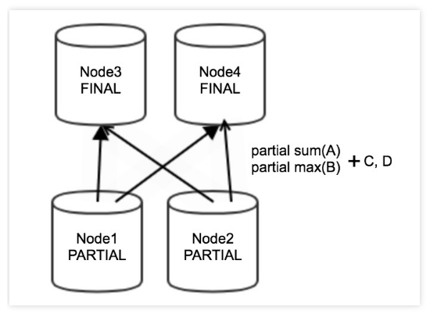
Grouping and Aggregation Process
Perform partial aggregation on data.
After partial aggregation is complete, redistribute data among nodes based on partial aggregation results obtained by grouping and then perform final aggregation.

Slide 9
